Slide 1

TEAM 5 – GPS MESSENGER
CSC 4360 – Mobile App Development
Members: Fergus Kelley, Mothibalaji Srinivasan, Ankush Chauhan, Swetha Paka, William Tyler McClain

Slide 2

GPS MESSENGER
Our application is a location based messaging service. It allows users to leave and view messages based on their position.
It is a simple way to share information about the area you are in, or learn from those who have been here before.
We envision it used in many ways, both by average users and by businesses.

Slide 3
Development Process
User Stories:
Envisioning how the app will be utilized by users.
Flow Chart:
A diagram showing how users will navigate through the app.
Story Boarding:
Creating a mockup of how walking through the app will look once completed.

Slide 4



Development Tools
Android Studio
-IDE
Firebase
-cloud database
-authentication
Slack
- communication

Slide 5
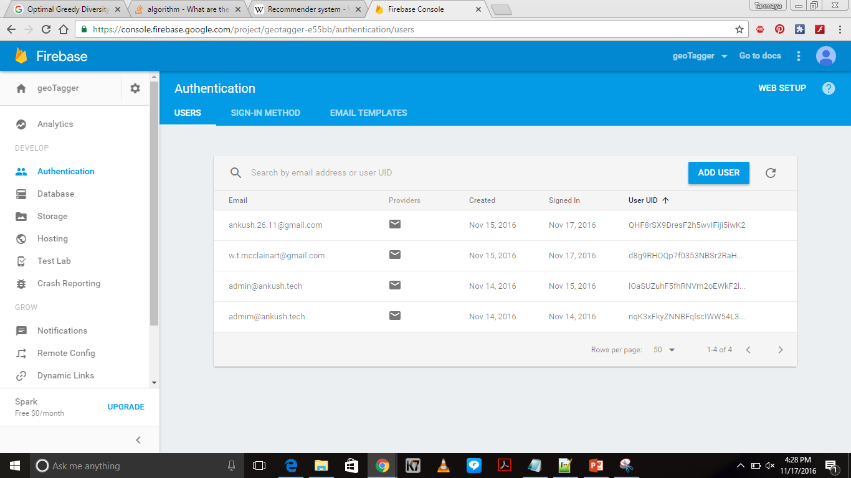
Authentication

Slide 6
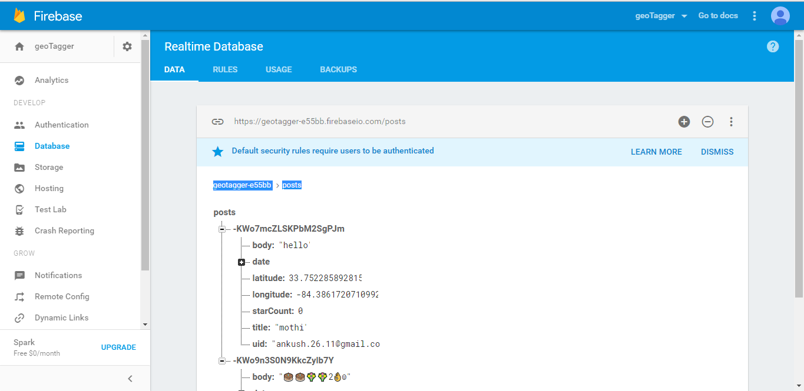
Realtime Database

Slide 7
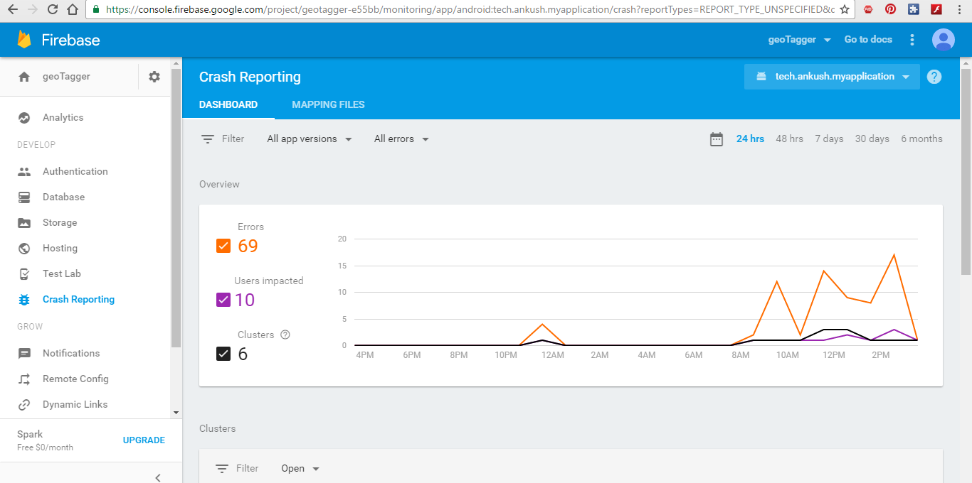
Crash Reporting

Slide 8
User Stories
Story 1 Scenario:
Create geographic scheduling for events As a conference organizer, I need an easy way for attendees to know what event is happening in each conference room. Using this app, I want to pin a list of events at the geographic location of each room so that all the attendees in a room can easily see the events scheduled for that room and have an easier conference experience.
Story 2 Scenario:
Create a scavenger hunt As a game designer, I need a way to create a scavenger hunt that combines the real world and the virtual world. Using this app, I want players to walk around the real world, solving clues pinned to the virtual map in particular locations. By solving a clue, the players would find the location of the next clue pinned to the app's map and have fun solving a challenge.

Slide 9
User Stories Continued
Story 3 Scenario: Finding My Lost Car
As a driver in a city I often have to park in large parking decks where it is easy to lose my car. I want to be able to leave a message when I park with information on my car’s location at the parking garage. Then when I return to the area where my car is I want to be able to access that message to help me find my car.
Story 4 Scenario: Moving My Class Location
As a teacher sometimes I move the location of my class for special events that are relevant to the courses I teach. I would like to be able to leave a digital message that is accessible to my students at my normal class location. If they were to accidentally go to our normal classroom they could access my message through their mobile devices. This message would contain the information about where class will be held so that they can still join the rest of the class at the event, and not miss out on important information.

Slide 10
User Stories Continued
Story 5 Scenario: Restaurant leaves daily specials
As a Restaurant Owner, I want this app to leave daily specials for the customers so that, people using this app people can view the specials without stopping by in person. Whenever there is a change in specials menu option it should be updated in handy. In addition to that the app should allow me to post additional offers for nearby school students at specific hours.
Story 6 Scenario: Store with a sale or special offer
As a Store Owner, I know when the business brings more people during festive seasons, but to increase my sales on normal days I want to use this app to give a FLASH sales where it will be completely unannounced and if users pass by near the store they should know about the sale and they can make use of it. This should benefit the user and attracts user based on the surprise offers during surprise hours

Slide 11
User Stories Continued
Story 7 Scenario: Leave Traffic/Construction information.
As a rider, I need to know the information of the ongoing traffic, if the road is being blocked or diverted due to construction. So that I will be able to not waste my time driving through heavy traffic and taking too many diversions in reaching my destination.
Story 8 Scenario: Leaving a review at a restaurant
As a customer, I would like to visit restaurants around the city, taste different dishes in the restaurants and finally write a review about the restaurant using the app so that is would be helpful for the people in choosing the restaurants better.

Slide 12
User Stories Continued
Story 9 Scenario: Tagging a path or shortcut
As an avid traveler, I want to drop a series of beacon markers on map to preserve found paths or shortcuts while traveling around then classifying them for your one trip and storing them in a time series. Later these markers can be realized to form an interpolated path of the steps taken in your travel history.
Story 10 Scenario: Leaving a URL containing information at a location
As an event organizer, I want my guests to find information using Web URLs which can be for checking-in, parking, etc. using contextual location based URL, saving their time would reduce their hassles at a new place.

Slide 13
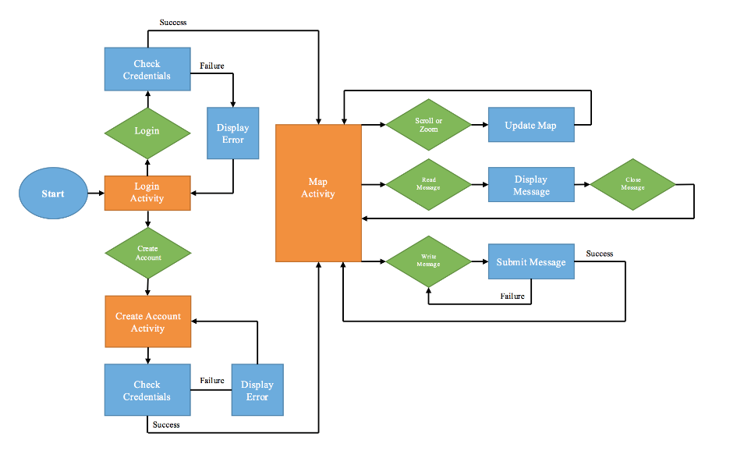
Flow Chart

Slide 14

The Story Board
How the app was originally envisioned to work

Slide 15
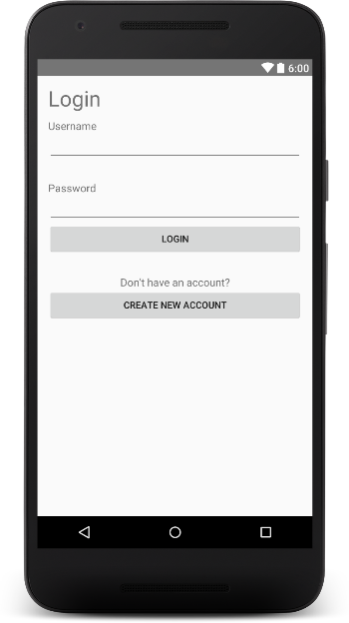
Login Activity
If the user has an account, entering in the correct credentials and hitting the LOGIN button will display the map activity.
Entering incorrect credentials will result in an error message being displayed above the LOGIN button.
If the user doesn’t have an account, hitting the CREATE NEW ACCOUNT button with display the create new account activity.

Slide 16
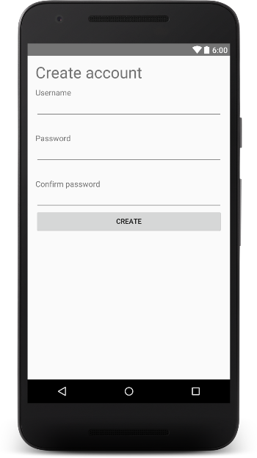
Create Account Activity
The user can enter in the information for a new account.
If the username already exists or the password fields do not match, an error message will be displayed above the CREATE button.
If the new account credentials are valid, hitting the CREATE button will display the map activity

Slide 17
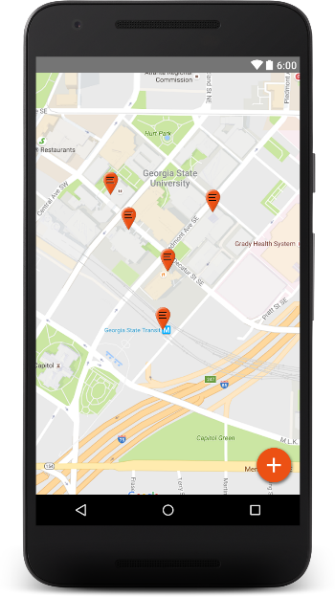
Map Activity
This is the main screen of the app.
Messages left by previous users are displayed as pins on the map.
The user can drag around the map and pinch to zoom.
Tapping a pin will re-center the map and display the message at that location.
Tapping the + button will allow the user to write a message and leave it at his or her current location.

Slide 18
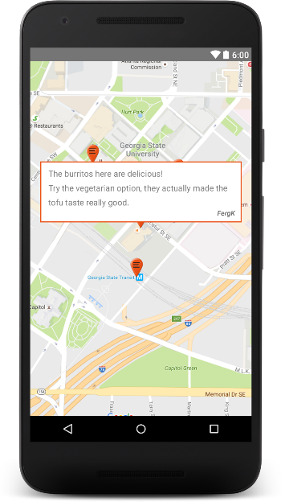
Display A Message
Tapping a pin on the map activity will re-center the map to that location.
The displayed message appears in a box above that pin.
The username of the person who posted the message is displayed in the lower right of the box.
The + button for writing new messages is hidden while displaying an existing message.
Tapping or swiping anywhere outside the box will close the message.

Slide 19
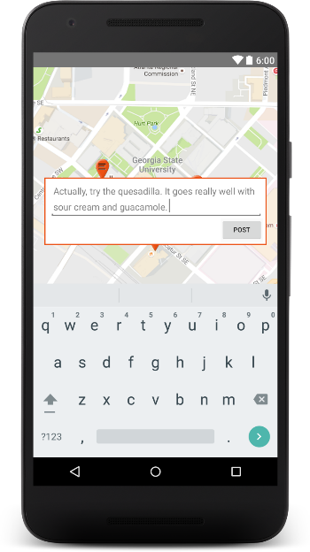
Write A Message
Tapping the + button on the map activity will allow the user to leave a message at the current location of the device.
A box appears with an editable text field along with the device’s onscreen keyboard.
Once the user finishes entering the message, tapping the POST button will make the box disappear and close the onscreen keyboard. A new pin will appear on the map containing the new message.

Slide 20
Demonstration
How the app actually works

Slide 21

Version 2
Privacy Settings
-Allow messages to be set as private, public, or for a specific group.
Groups
-Allow users to form groups based on need for work, school or other activities.
Timed Messages
-Messages expire in a given amount of time.

Slide 22
Version 2 continued
Messages Snap to location
-All messages in an area will be brought together and displayed together
Message Ranking
-Users rank the value of messages for display hierarchy
Message Ranking
-Users rank the value of messages for display hierarchy

Slide 23
Thank You
From the team behind GPS Messenger

